Slide 1

Group 3 Members
Abubakari-Sadique Hamidu
Papa Ekow Amonoo
Chilufya Theresa Mulenga
AI Moderation in African Languages: Detecting Hate Speech in Swahili
Group 3 – Trust and Safety Fellows
Institution: Trust and Safety Africa Academy
Capstone Project Presentation
TRUST
AND
SAFETY
A Machine Learning Approach to Contextual Moderation in Swahili

Slide 2
Background Research
Global Problem: Hate speech online fuels violence, polarization, and discrimination.
Local Context: African languages are underrepresented in moderation systems.
Swahili Focus: With over 100M speakers, Swahili is widely used on social platforms.
Gap: Existing AI tools lack linguistic and cultural understanding of Swahili

Slide 3
Problem Statement
Most AI moderation tools do not support African languages, especially the most popular ones, like Swahili.
Social media platforms in East Africa lack efficient hate speech detection.
Manual moderation is slow, inconsistent, and costly.
This project aims to fill this gap using machine learning and local language data.

Slide 4
Objectives
Build a binary classification model to detect Swahili hate speech.
Preprocess Swahili text data using NLP techniques.
Train and evaluate a baseline ML model (Logistic Regression).
4. Provide a scalable foundation for moderation in other African languages.
Meta, Google, and TikTok have AI moderation models but limited coverage of African languages

Slide 5
Methodology Overview
Steps Taken
1. Dataset Collection
2. Data Cleaning & Preprocessing
3. Feature Extraction
4. Model Training
5. Evaluation
6. Testing & Inference
Tools: Python, scikit-learn, NLTK, Google Colab

Slide 6
Dataset Description
Custom dataset with 200 Swahili statements
Each labeled as:
1 = Hate Speech
0 = Non-Hate Speech
Examples:
Hate Speech: “Wale watu wa mtaa ule wanastahili kupigwa!”
Not Hate Speech: “Habari yako ndugu yangu.”

Slide 7
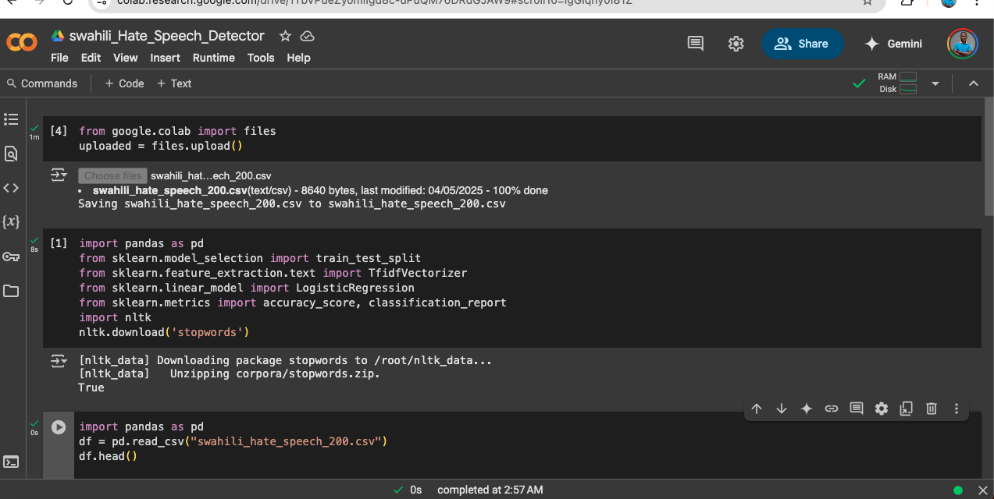
MODEL DEVELOPMENT - Platform: Google Colab
Step 1: set-up environment
Step 2: import libraries
Step 3: Upload and Load Dataset

Slide 8
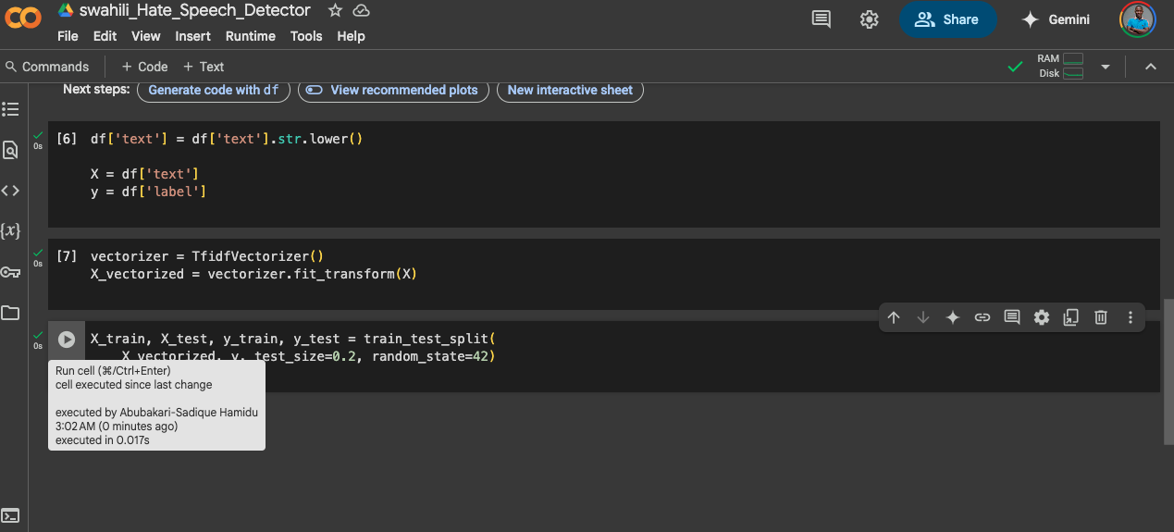
MODEL DEVELOPMENT - Platform: Google Colab
Step 4: Data Preprocessing
Step 5: Feature Extraction – TF-IDF

Slide 9
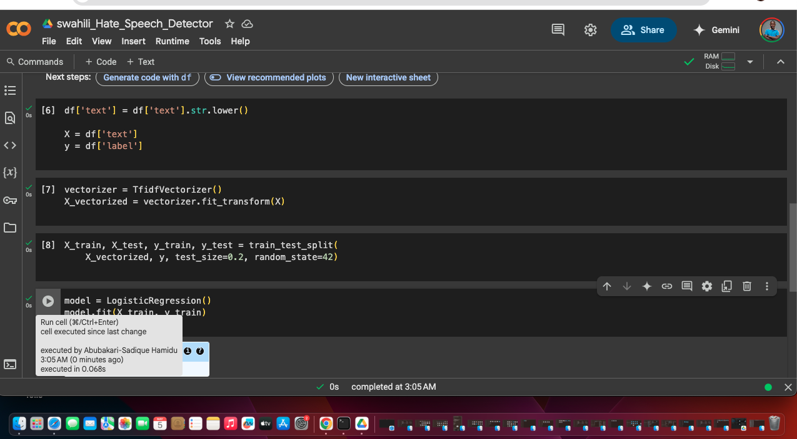
Model Training Chosen Model: Logistic Regression
Reason: Lightweight and interpretable
Step 6: Train-Test Split
Step 7: Train the Model

Slide 10
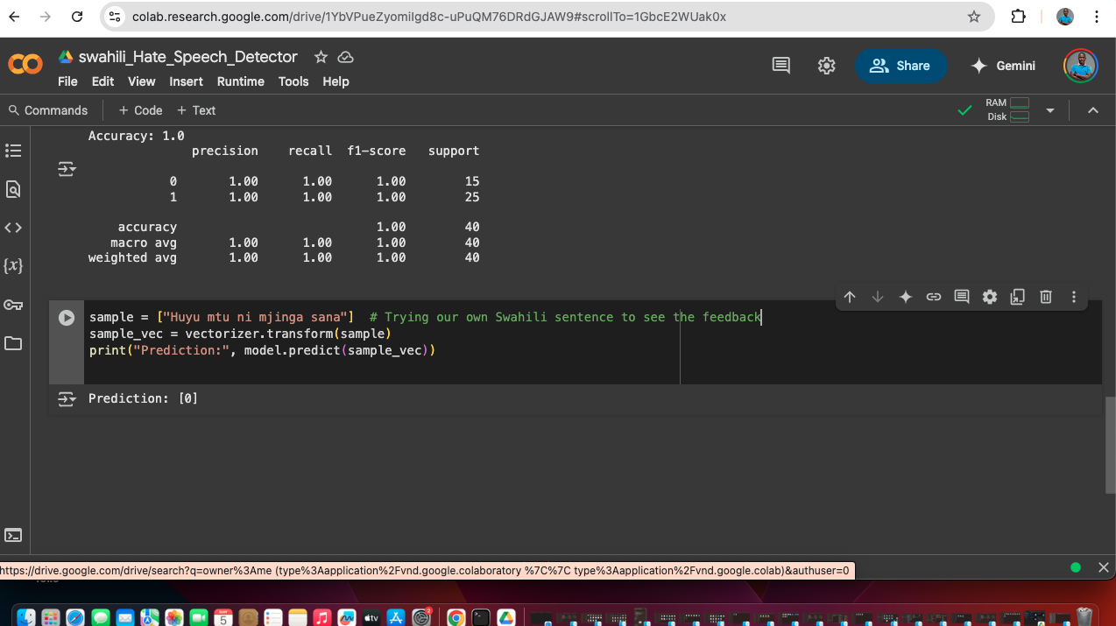
MODEL EVALUATION AND TESTING
Step 8: Evaluate the Model
Step 9: Test with New Input

Slide 11
Model Evaluation Results
✅ Accuracy: 100.00%
Class | Precision | Recall | F1-score | Support
0 (Non-Hate) | 1.0 | 1.0 | 1.0 | 15
1 (Hate) | 1.0 | 1.0 | 1.0 | 25
Total Samples = 40
🧠 Interpretation
The model correctly predicted all hate and non-hate speech samples.
Precision, Recall, and F1-score of 1.00 indicate perfect classification.
This is a strong result, but testing on a larger, more diverse dataset is recommended to confirm real-world performance.

Slide 12
Future Work
Use AfroBERT for better language context
Expand dataset to include regional dialects
Build a REST API for integration with apps
Explore multilingual moderation (e.g. Hausa, Twi, Yoruba, Moore)

Slide 13
Conclusion
Demonstrated a working AI model for hate speech in Swahili
Provides a foundation for ethical moderation in African languages
Reinforces the mission of Trust and Safety Africa Academy

Slide 14
Acknowledgements
Trust and Safety Africa Academy
Group 3 Fellows:
- Abubakari-Sadique Hamidu
Email: abubakarisadiquehamidu@gmail.com
- Papa Ekow Amonoo
Email: pekowamonoo@gmail.com
- Chilufya Theresa Mulenga
Email: mulengachilufya46@gmail.com
Mentors and Support Staff at Trust and Safety Africa Academy
Links
Model: https://colab.research.google.com/drive/1YbVPueZyomiIgd8c-uPuQM76DRdGJAW9?usp=sharing

